Slide 1
Grønland’s mining history - Maarmorilik and Ivittuut
By the end of this session, you will know:
Why men mined in Grønland despite arctic challenges
What working in the mines was like
How mining affected local environments and what can be learned from these impacts
Why Grønland’s resources still matter today
Click to start

Slide 2
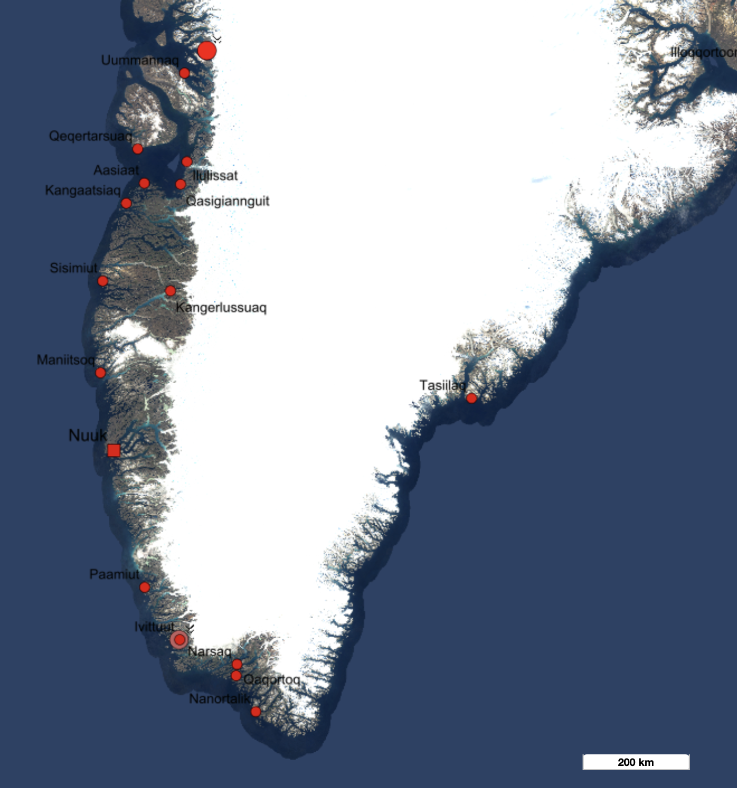
Geographic Overview
As most of Greenland’s settlements, both the abandoned mining towns discussed in this slide show are situated on the west coast:
Maarmorilik and Ivittuut
Click the orange circles to find out more about Greenland’s forgotten mining history!

Slide 3
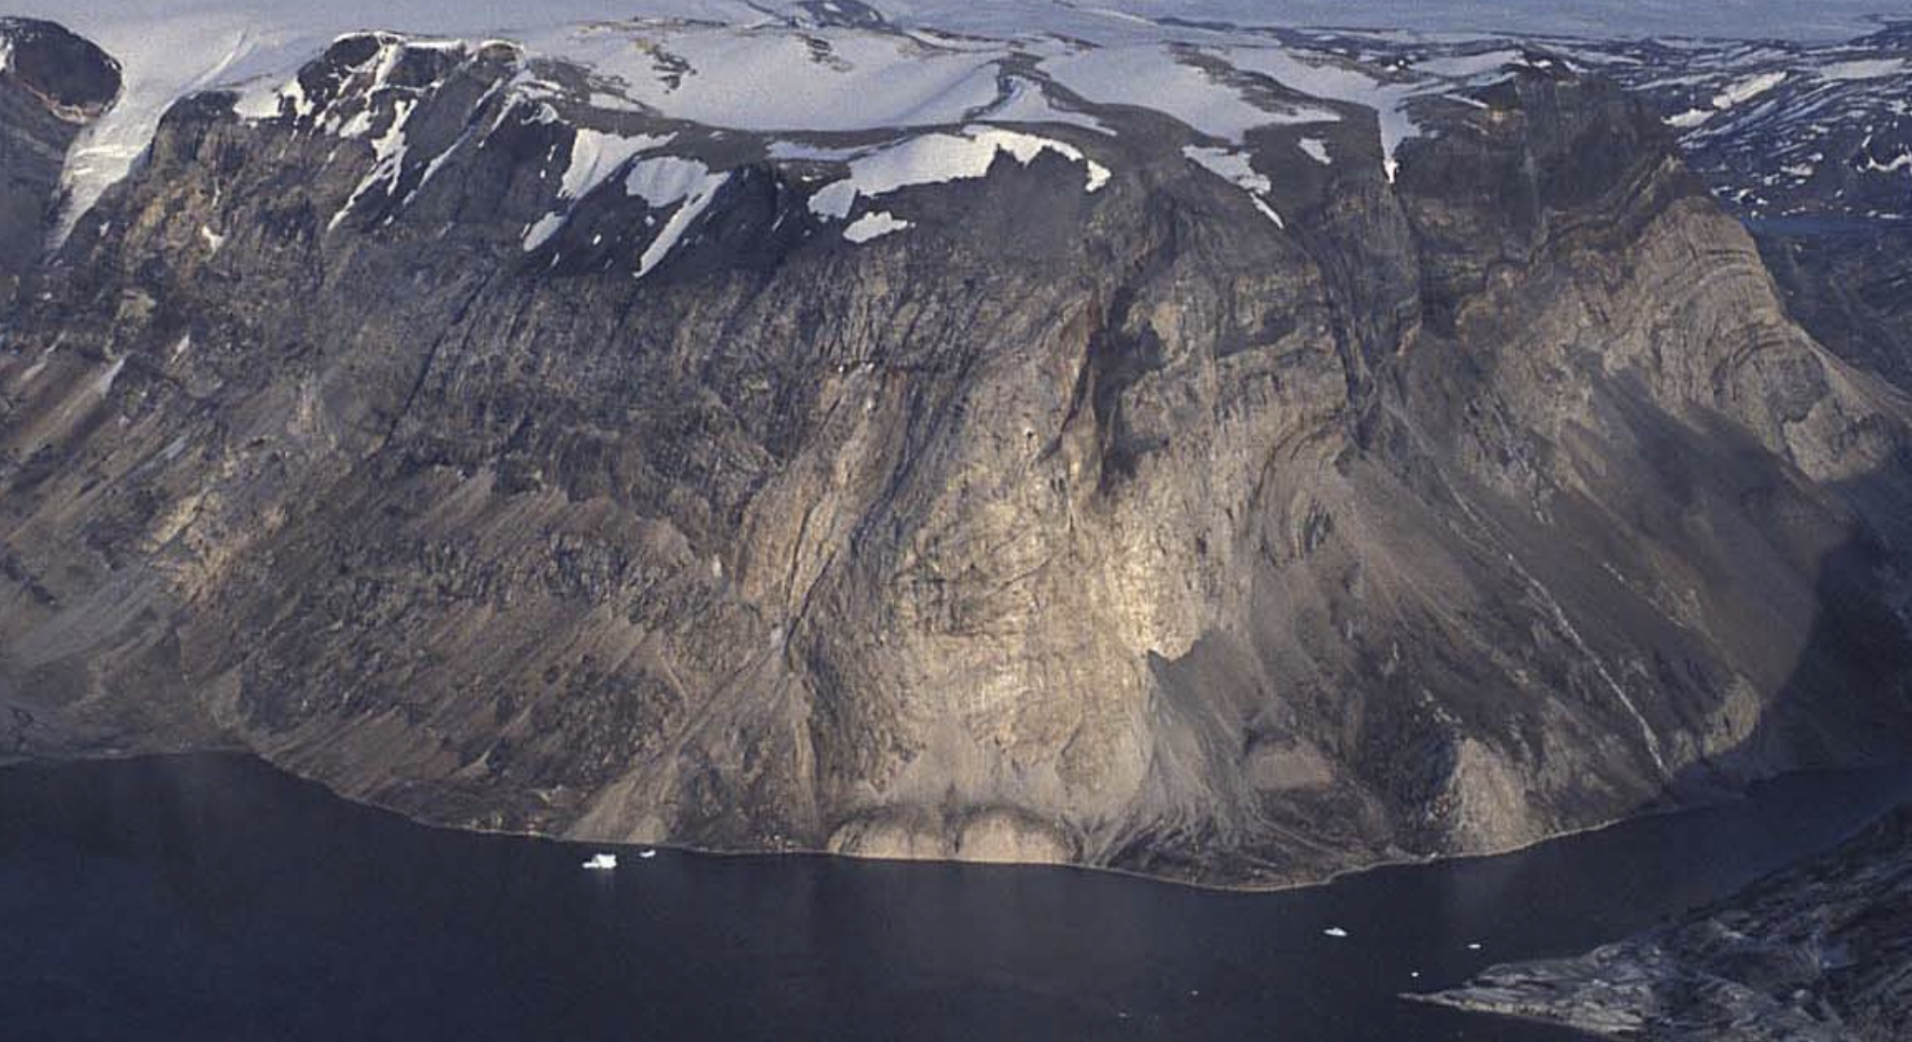
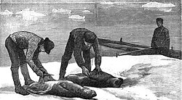
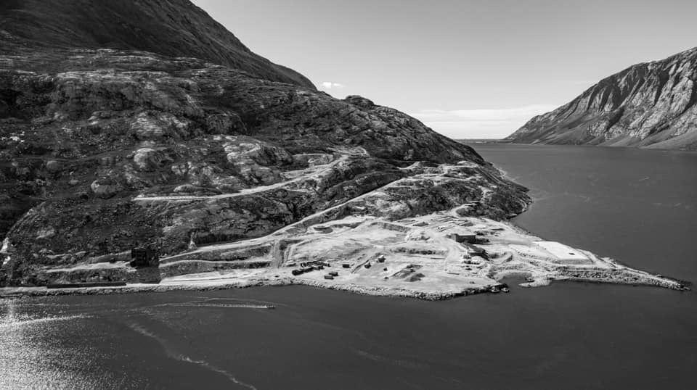
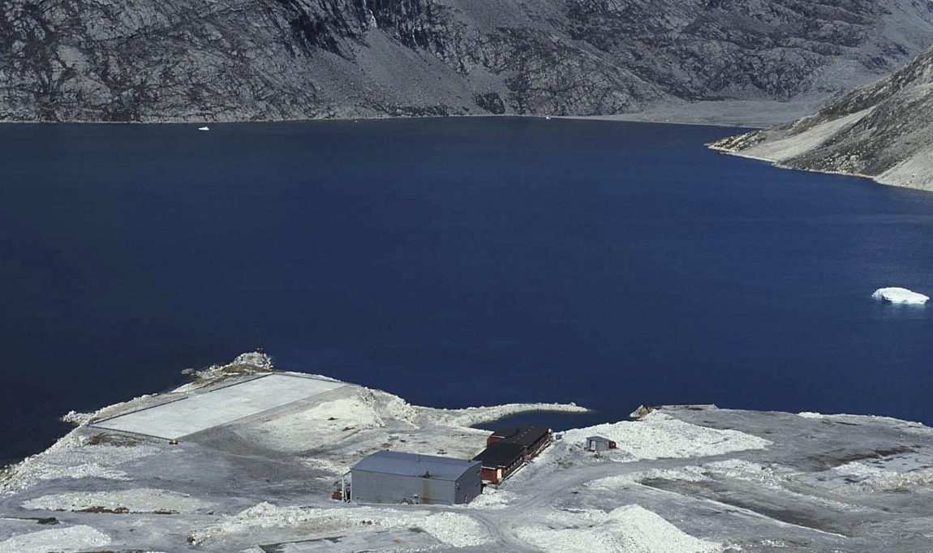
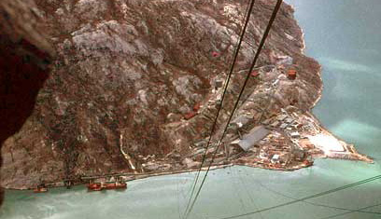
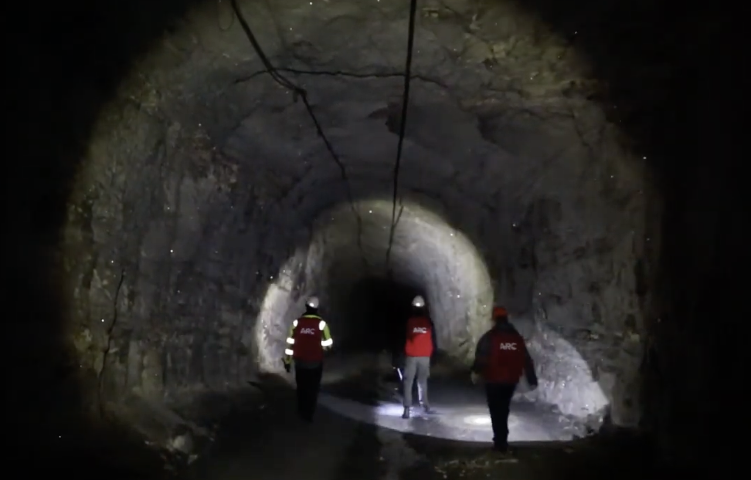
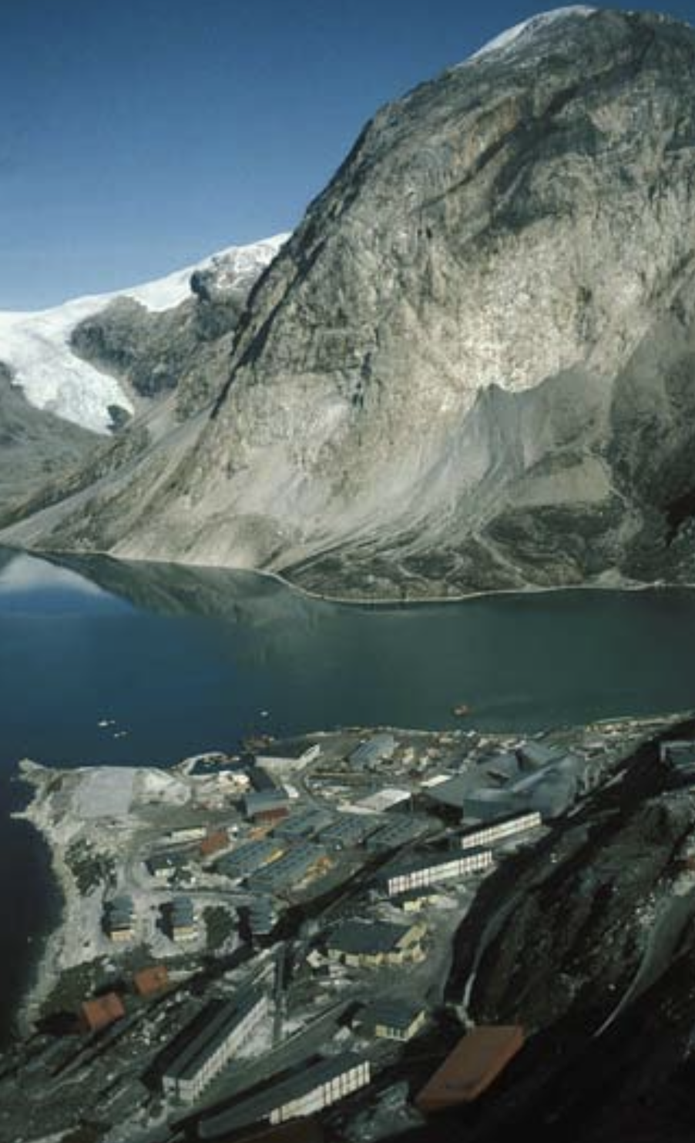
Black Angel – Part of Greenland’s Mining History
1975
1960’s
1991
1973
2008 - now
1980’s
Return to map

Slide 4
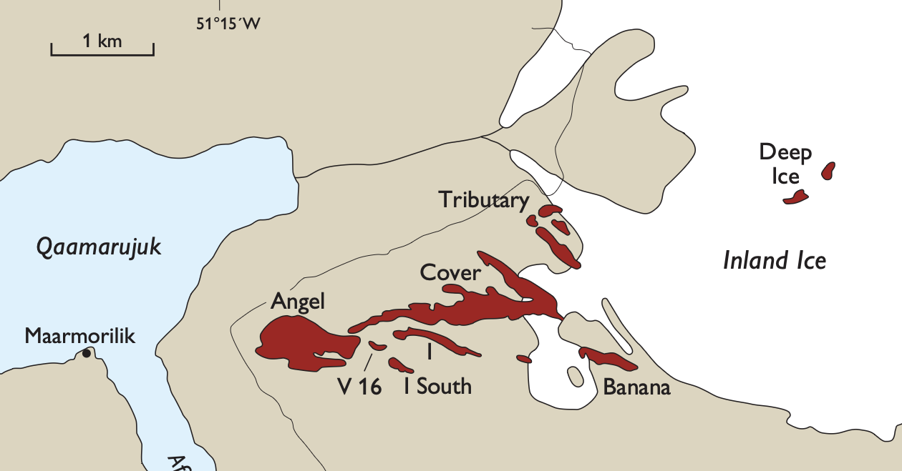
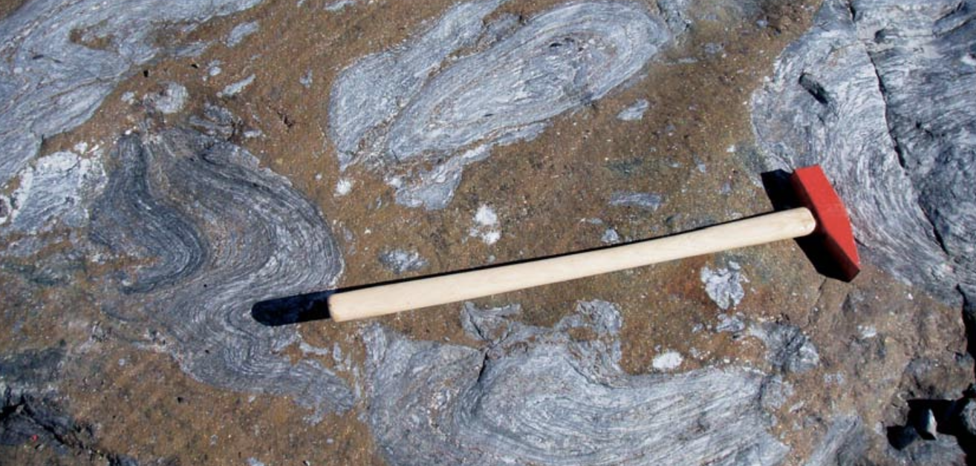
Maarmorilik, 1960’s
Geological Exploration
After marble had been mined here for at least 30 years – giving the village its name – geological exploration in the 1960’s finds a remarkable occurrence of Lead and Zink. The deposit is called Den Sorte Engel (Back Angel) after a characteristic outcrop of dark sediments in the cliffs.
Click the pictures on the right for more information about Black Angel’s geology and ore.
Return to timeline
Top: map of deposit zones (red). Bottom: Sulphidic ore minerals oxidize at outcrop, creating a characteristic red staining.

Slide 5
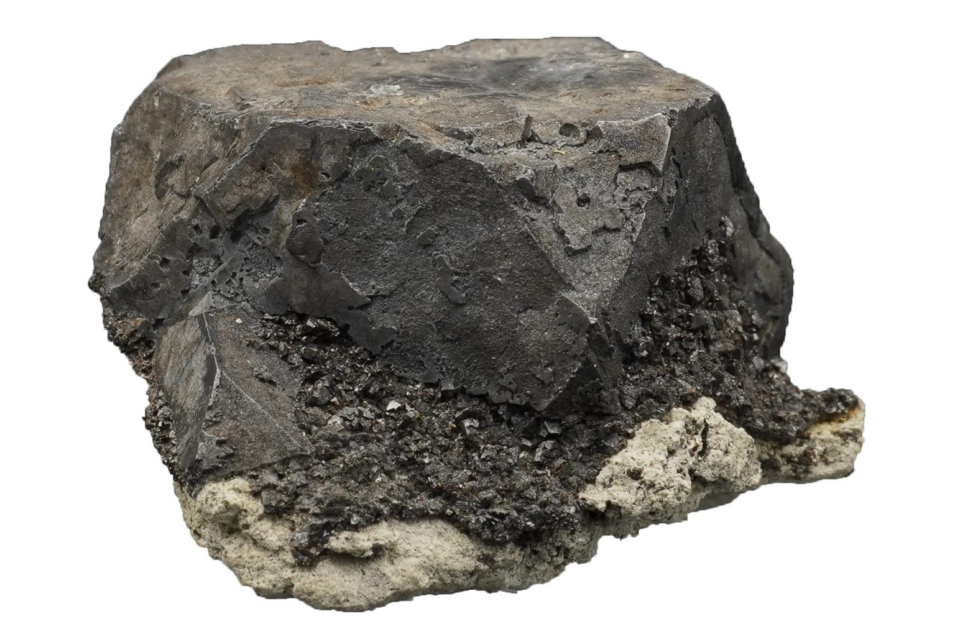
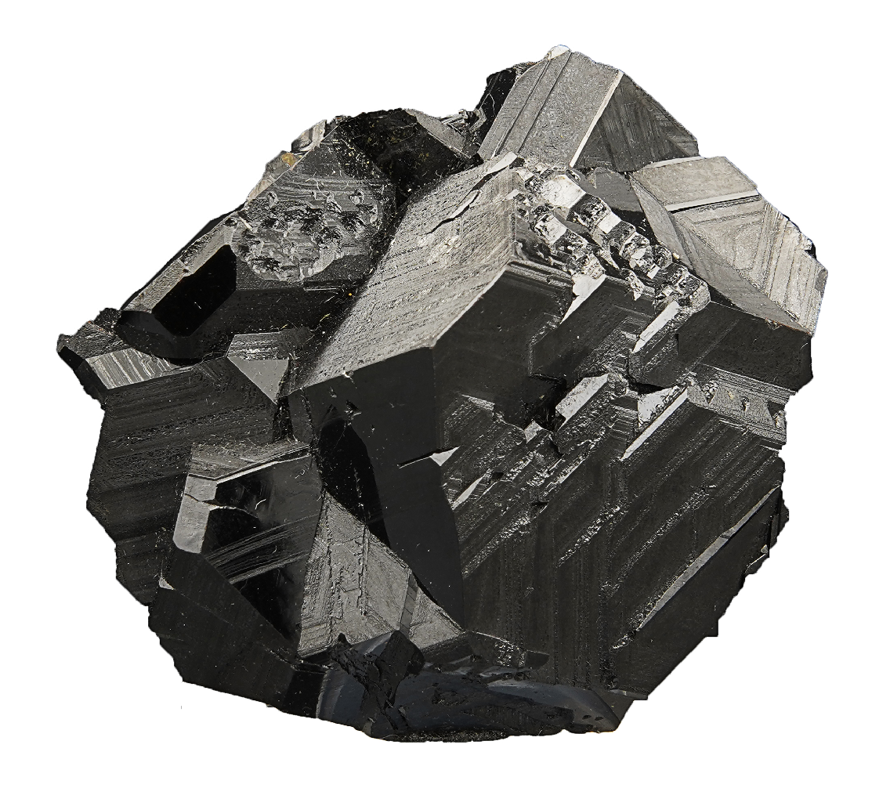
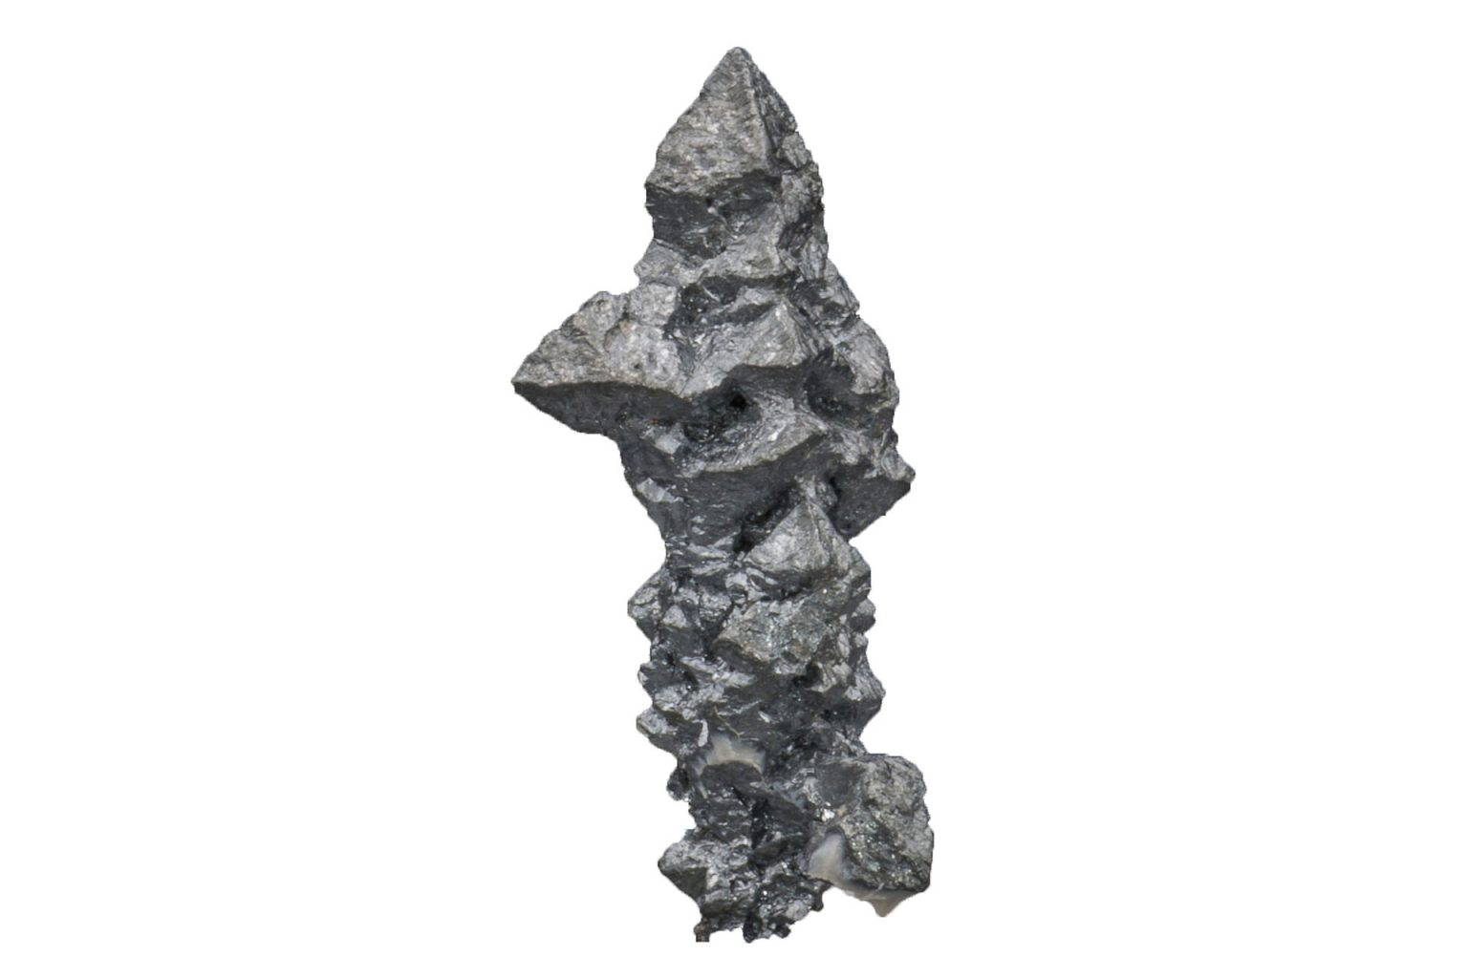
Maarmorilik, 1960’s
Why mine here? - Black Angel’s geology and ore
Deposit was formed by limestone sediments and metal-enriched fluids in an ancient sea (ca. 2 Ba ago)
Tectonics later folded and thickened metal-rich layers and turned the limestone into marble
Ore now occurs as lens-shaped bodies inside the mountain
The ore consists mainly of the minerals sphalerite (zinc) and galena (lead), with silver as a valuable by-product
Black Angel was exceptional because of very high metal grades
Click the minerals for more info about the valuable metals contained
Return to timeline
Galena (Pb)
Spahlerite (Zn)
Acanthite (Ag)

Slide 6

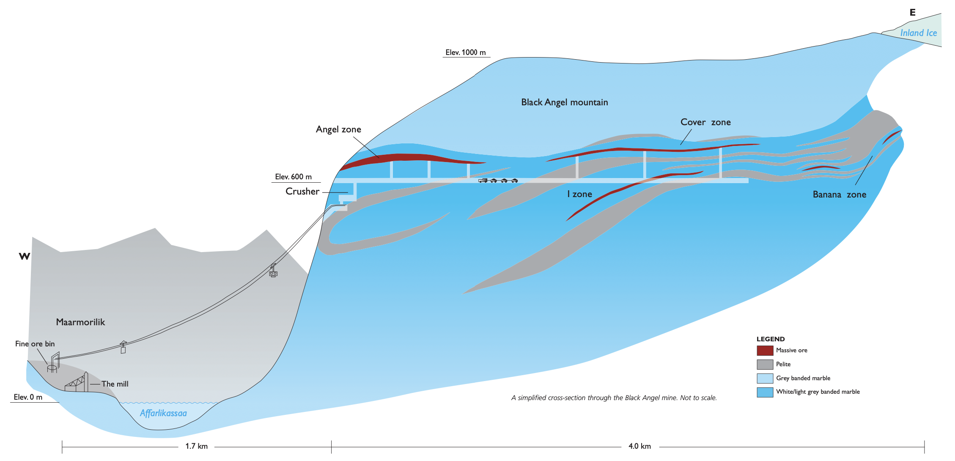
Black Angel Mine, 1973
Mining begins after permission
was granted (1971)
How was ore extracted?

Slide 7
Black Angel Mine, 1973
Mining begins after permission
was granted (1971)
How was extracted ore transported?

Slide 8
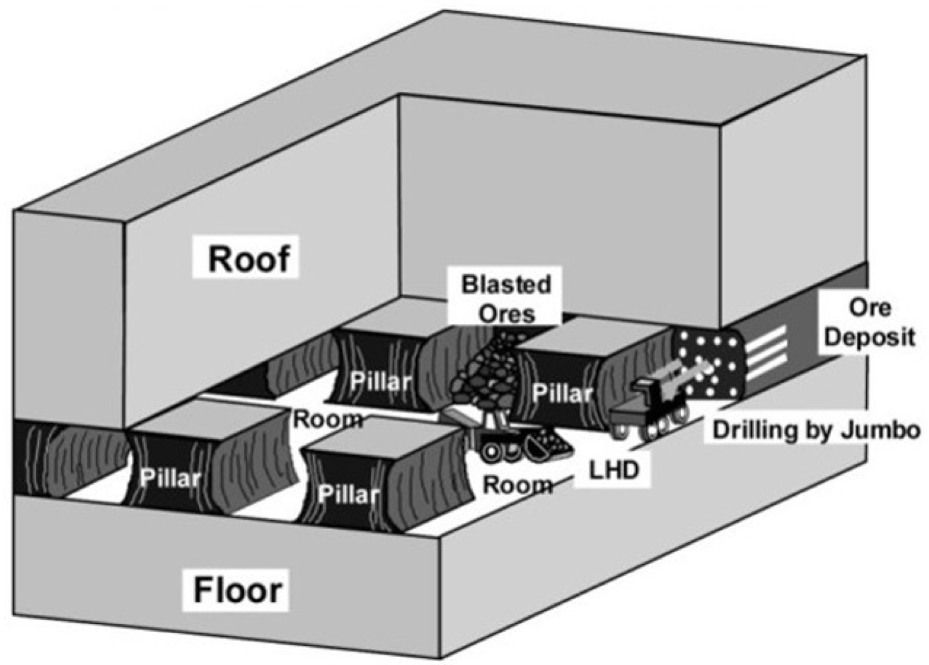
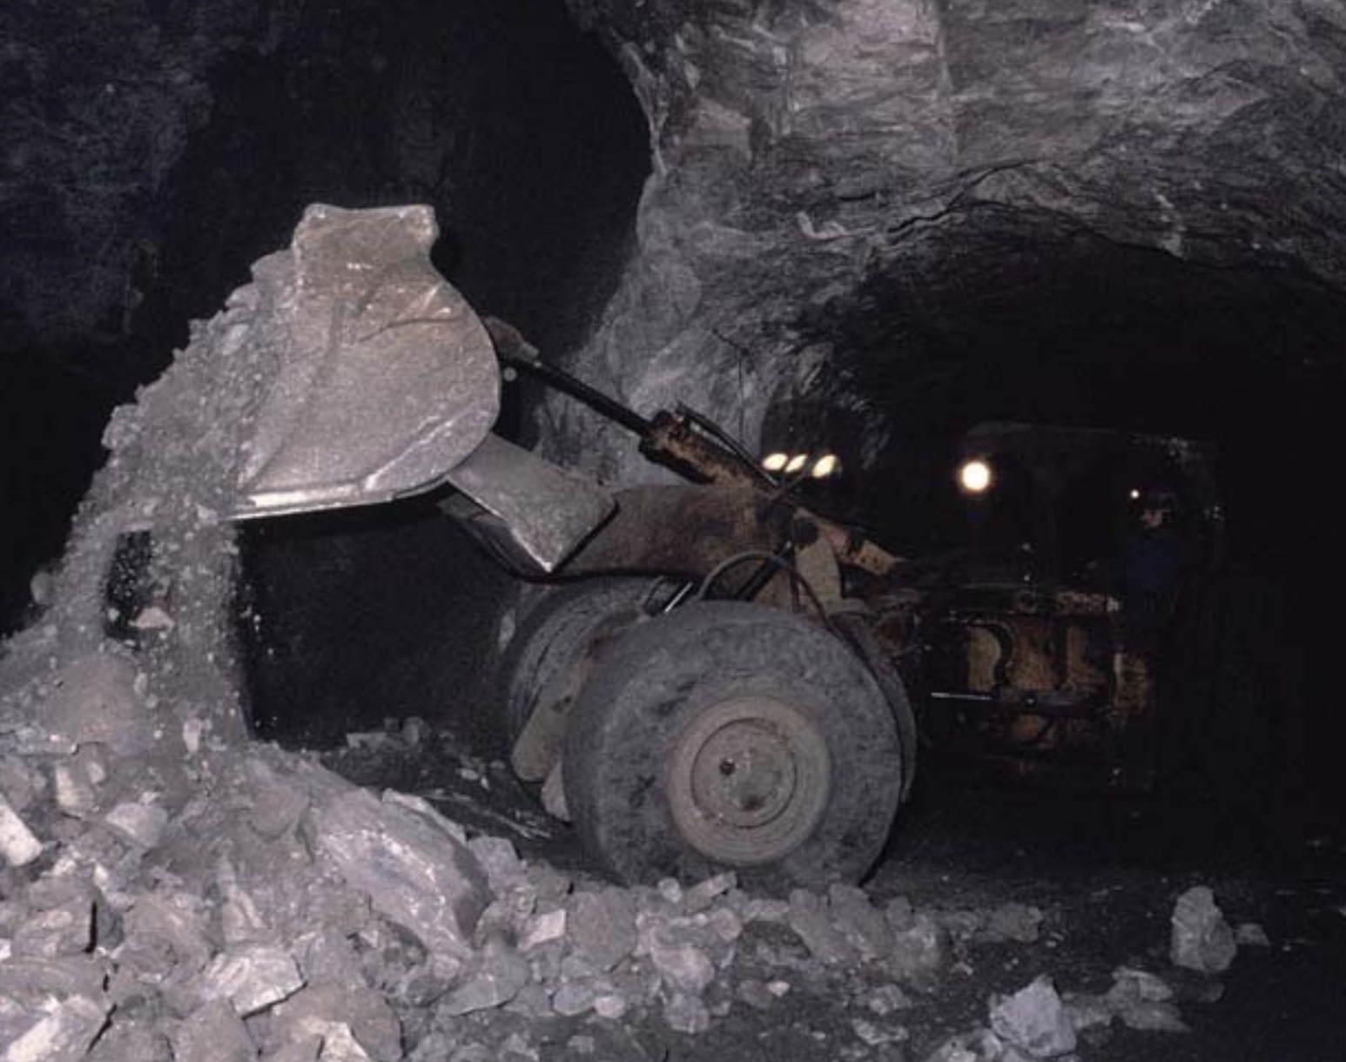
Mining methods, transport and logistics at Black Angel
Extraction
Competent rock & permafrost enabled un-
supported mining method: Room and Pillar
Pillars = ore losses. Can be reduced with ex-
tensive rock mechanics and selective mining
Late mining activities included pillar recovery,
which maximized the extracted reserves using
backfill to support the roof (overlying strata)
Simplified room & pillar design
Parameter | Deposit (Ore) |  |  | Production |  |  | Recovery
 | Tonnage Mt | Pb % | Zn % | Tonnage Mt | Pb % | Zn % | Ore tonnage % | Metal content %
Value | 13.557 | 4.0 | 12.3 | 11.196 | 4.1 | 12.6 | 82.6% | 84.6%
i
i
i
Return to overview
LHD (load, haul, dump machine) in operation at black angel mine

Slide 9
Additional Info for table
Black angel deposit and production figures
Parameter | Deposit (Ore) |  |  | Production |  |  | Recovery
 | Tonnage Mt | Pb % | Zn % | Tonnage Mt | Pb % | Zn % | Ore tonnage % | Metal content %
Value | 13.557 | 4.0 | 12.3 | 11.196 | 4.1 | 12.6 | 82.6% | 84.6%
Deposit (Ore) – this addresses the orebody estimated prior to extraction
  Tonnage – the weight of rock mass classified as ore in Mt
  Pb %, Zn % – the ore grade of metal contained in ore in % for Lead and Zinc, respectively
Production – this addresses the ore that was actually extracted from the mine site
Recovery – the share of ore, respectively metal, that was actually extracted from the orebody
  Ore tonnage % = Tonnage (Production) / Tonnage (Deposit)
  Metal content % = (Tonnage * (Pb % + Zn %) (Production)) / (Tonnage * (Pb% + Zn %) (Deposit))
Return to slide

Slide 10
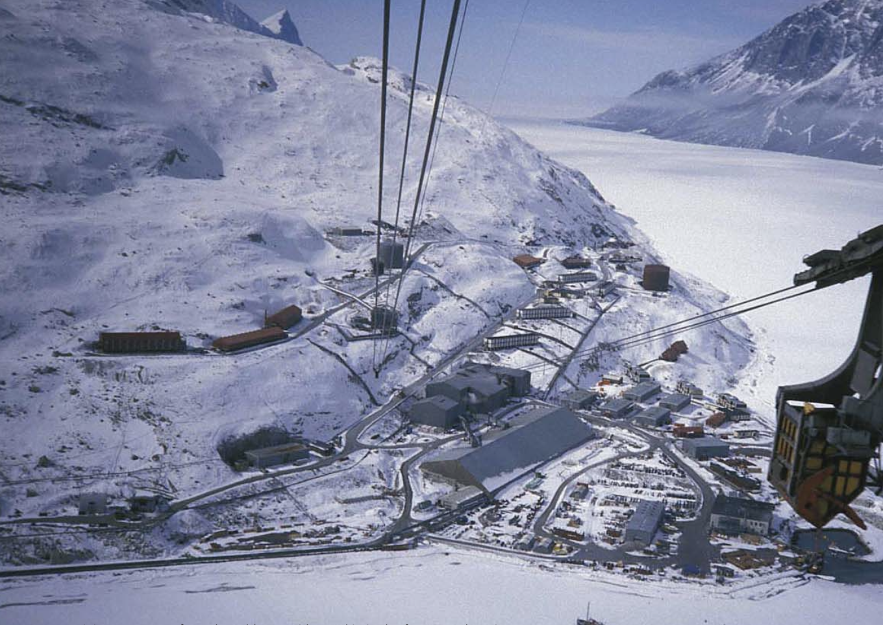
Mining methods, transport and logistics at Black Angel
Transport and Logistics
One of the least accessible mines worldwide
Underground haulage by LHDs, trucks, and locomotive
Primary crusher and intermediate storage at the portal
1500m aerial tramway to transport ore, staff and material
Concentrator plant in Maarmorilik
Shipment within a window of 6 months in summer due to
frozen fjords
View from the cliff on the areal tramway and the village in winter, frozen fjord not passable.
Return to timeline

Slide 11
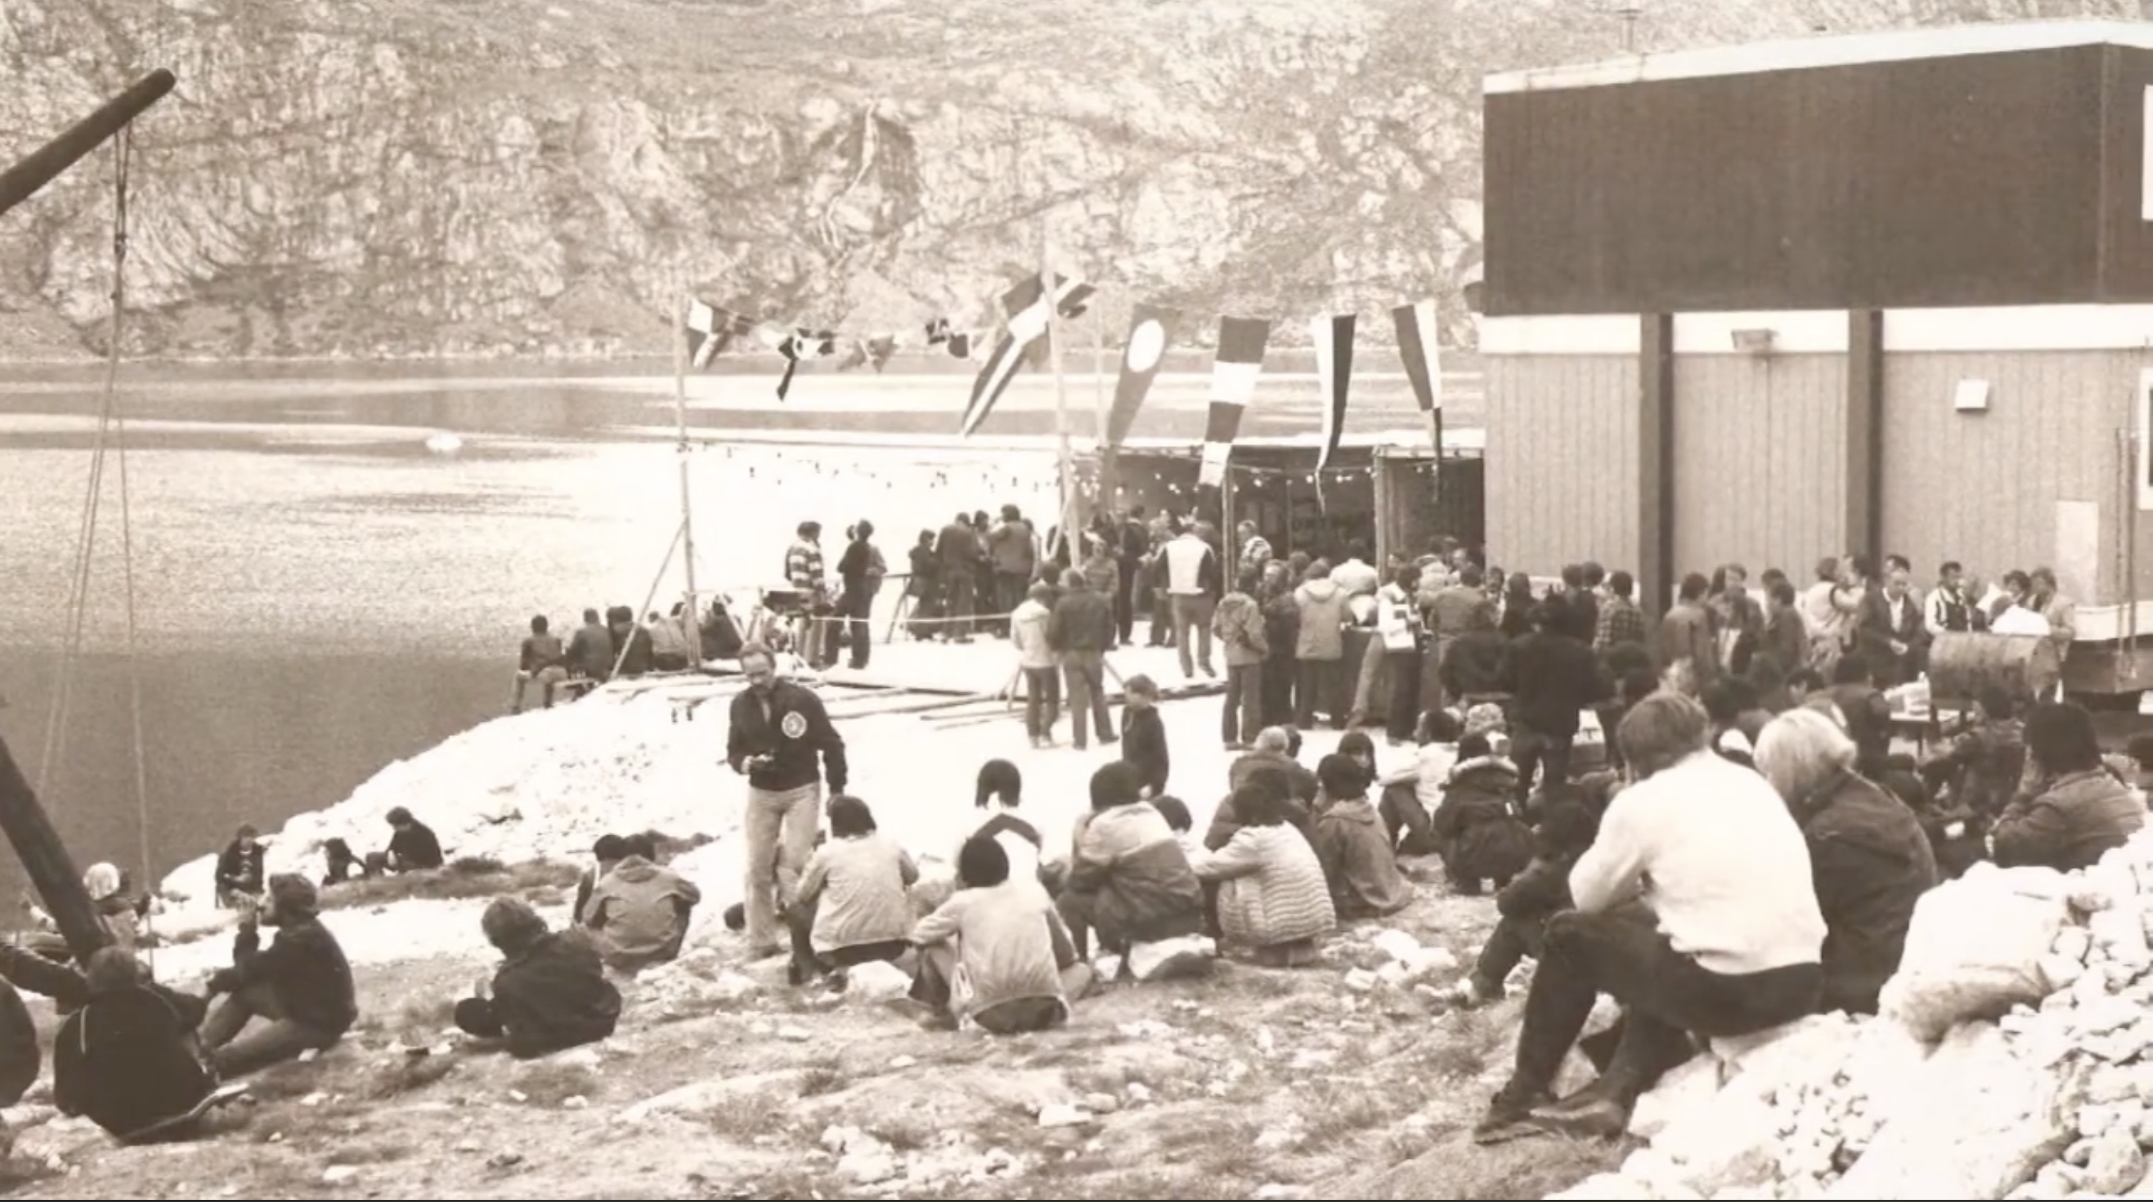
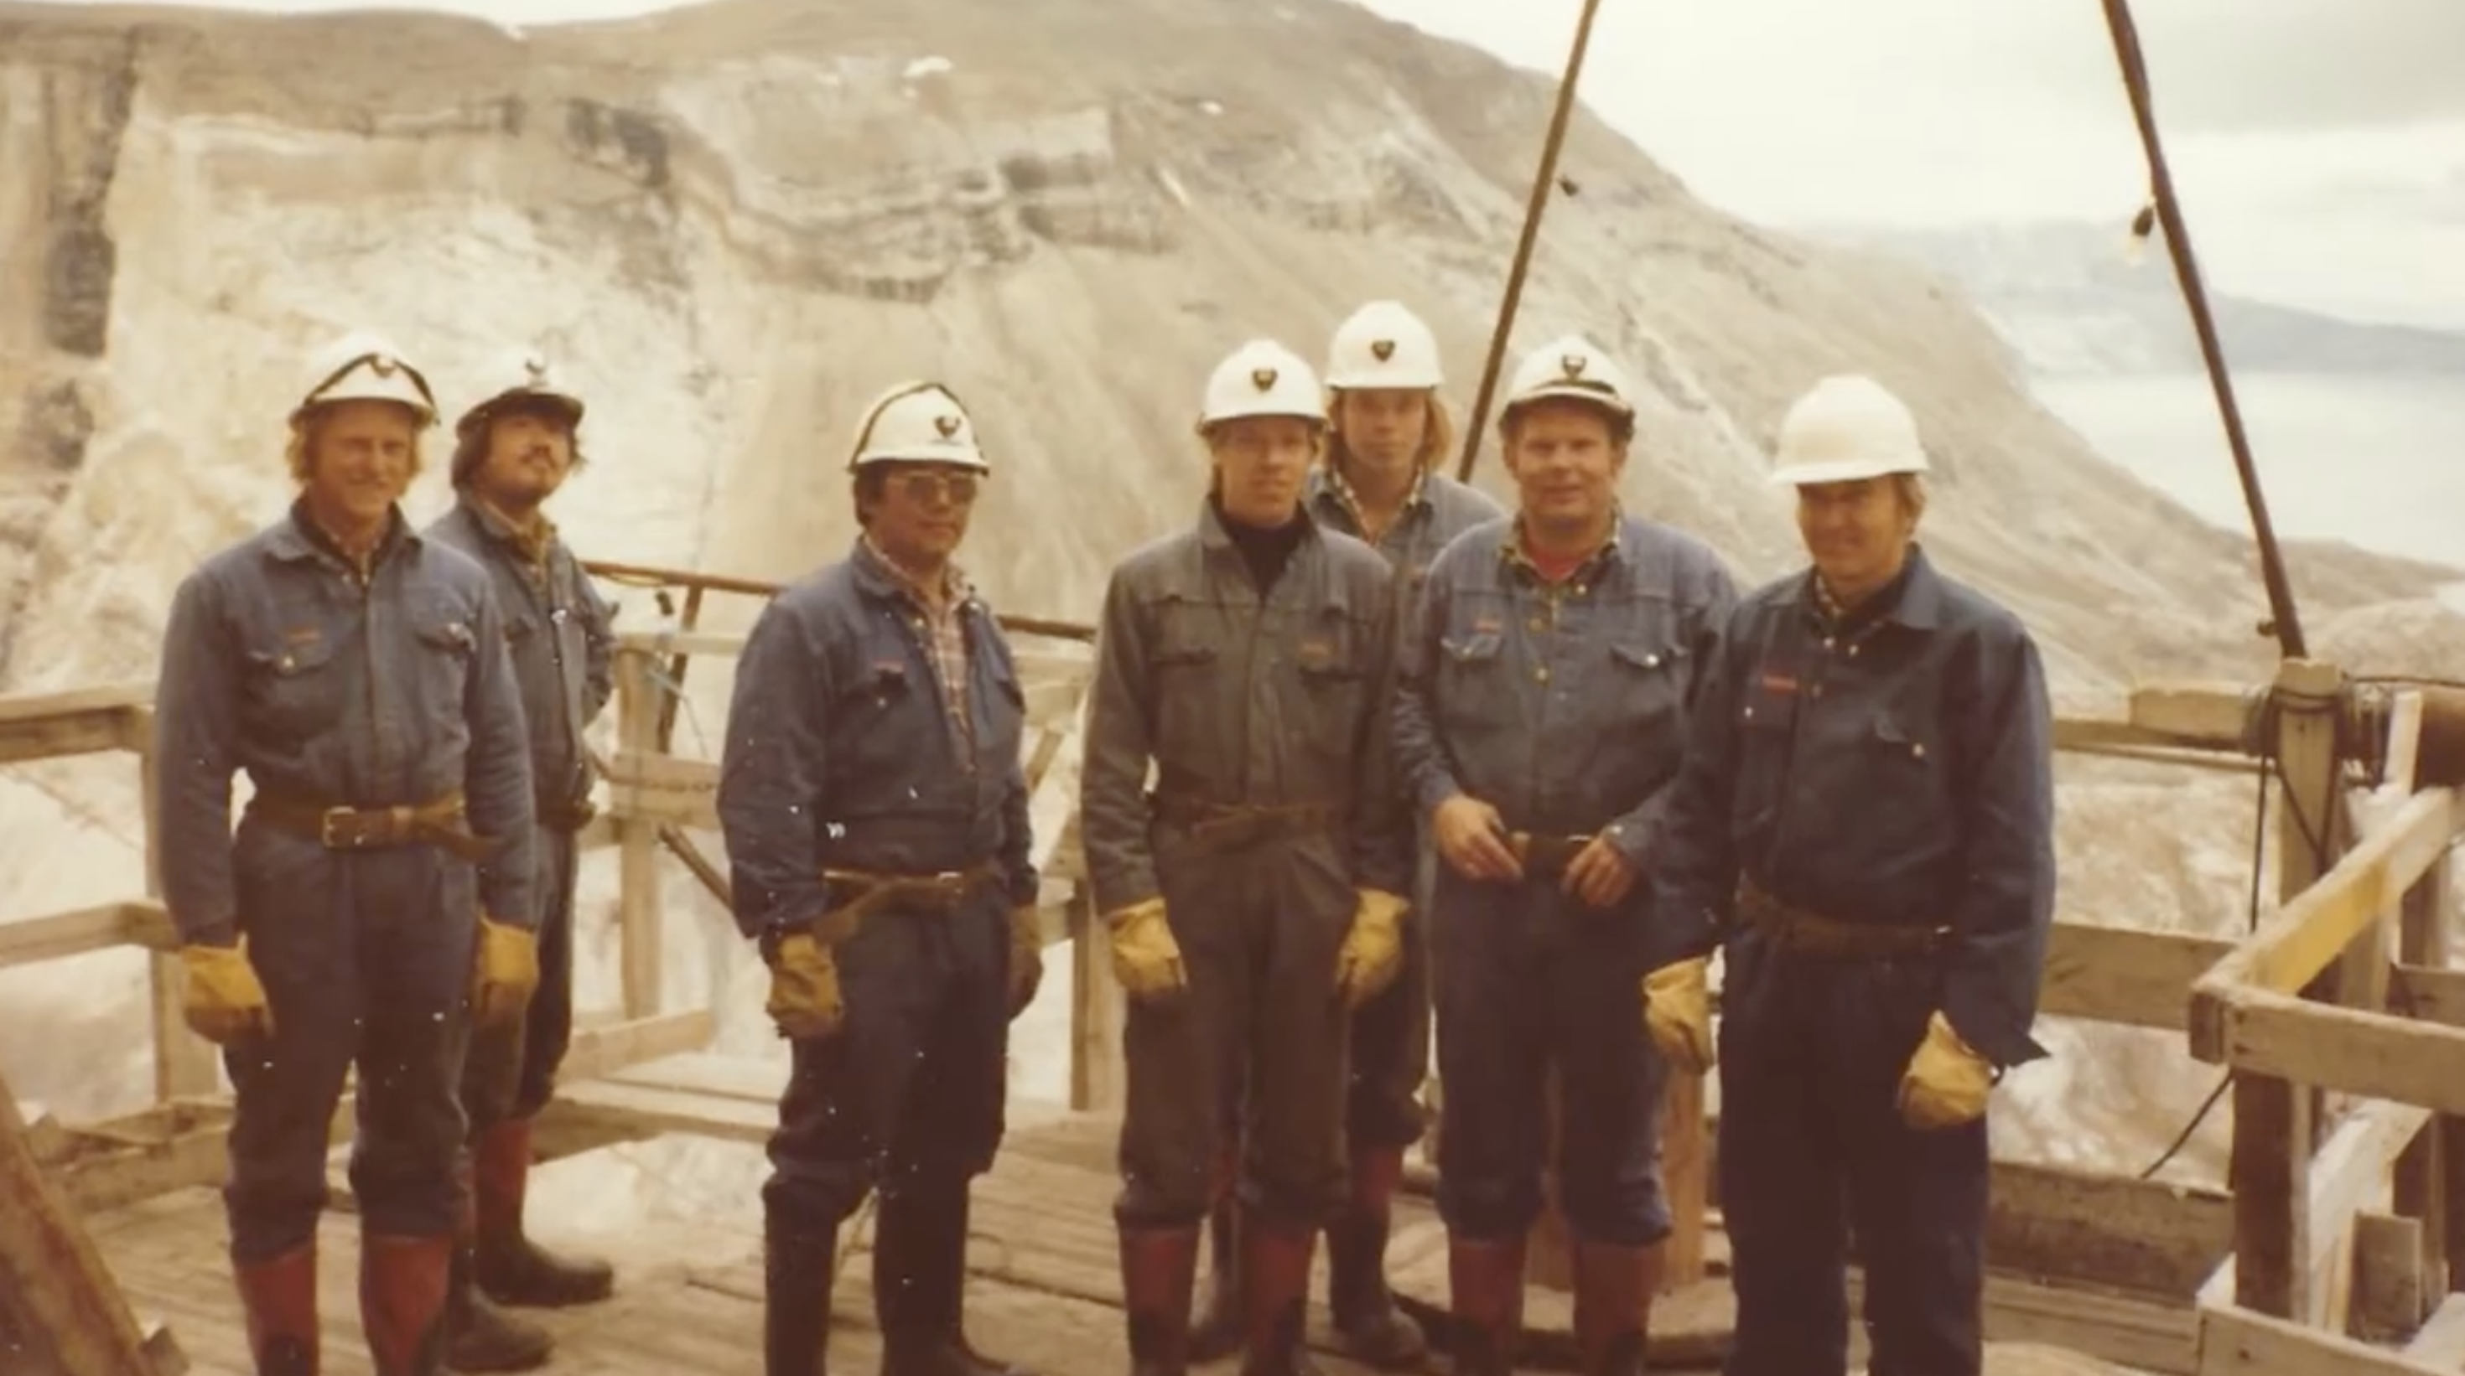
Black Angel Mine, 1975
Working and living in Maarmorilik
A mix of 350 (at peak times) Grønlanders, Dens and Swedes worked in the Black Angel Mine. Despite long shifts of ten hours, six days a week, workers were proud of their locally-build know-how and skills. Additionally, they earned one month off after four months on site.
Return to timeline

Slide 12
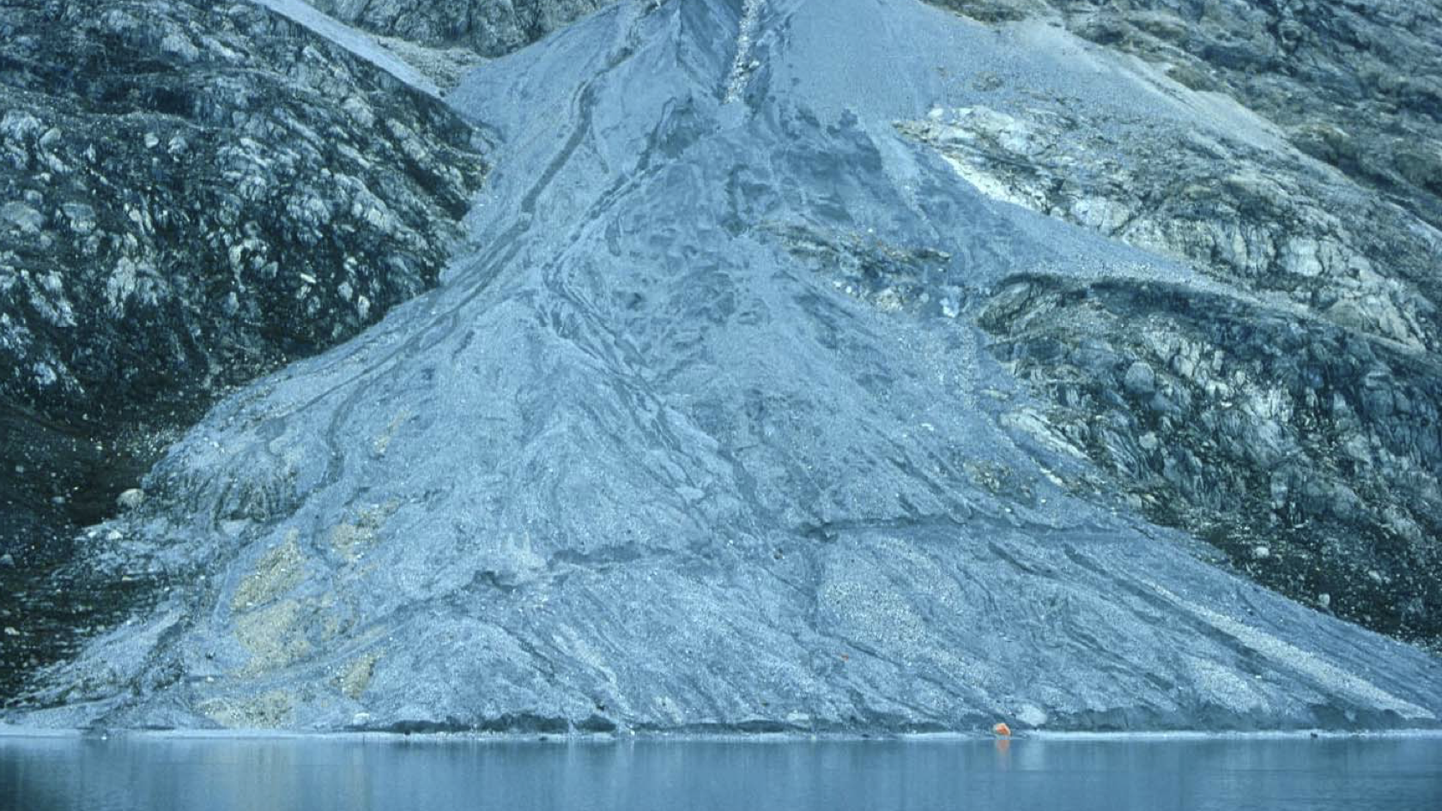
Black Angel Mine, 1980’s
What went wrong? - Environmental pollution
Mining caused lead and zinc contamination of the fjord, particularly in the first years of mining.
Increased metal levels were found in water, sediments, seaweed, mussels, and fish.
Main sources of contaminant were
  Waste rock with low mineralization, disposed of on the cliff outside the mine.
  Depleted sands from processing (tailings), disposed of in the fjord.
In 1975, local seal hunters protested against pollution by blockading an ore ship.
Elevated metal levels in biota (mussels) even in 2010.
Have there been any consequences? What can we learn from this case?

Slide 13

Black Angel Mine, 1980’s
What was learned? - Shift towards more sustainable mining
Authorities demanded improvement of environmental situation
Measures have been implemented:
  Waste pile was moved away from tidal zone
  Tailings metal content was significantly reduced
Monitoring data shows that contaminant levels decreased during ongoing mining activities and particularly after mine closure.
Water samples from 2010 show element concentrations below EU drinking water standards.
Nowadays, land, water, and biota degradation by mine wastes, as well as rehabilitation issues, are increasingly addressed by the mining industry and authorities.
However, mine wastes remain a major challenge for modern society.
Return to timeline

Slide 14
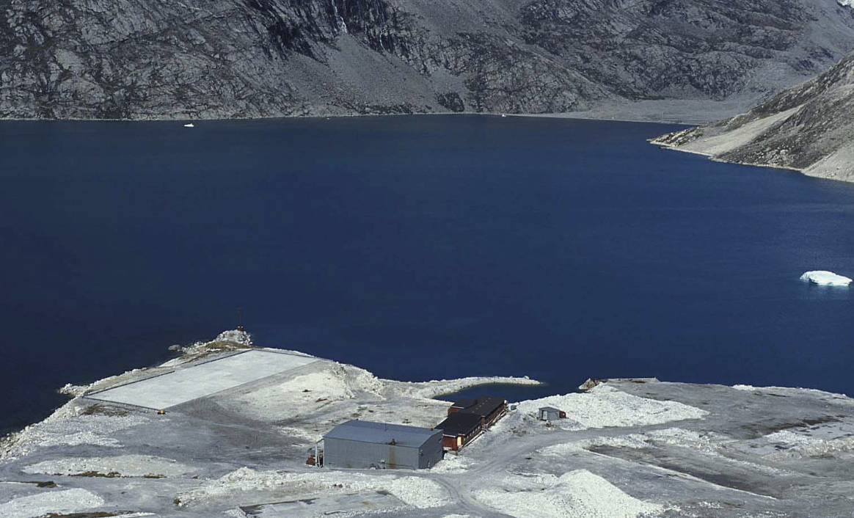
Maarmorilik, 1991
Black Angel Mine closes after 17 years of operation
Over its lifetime, the mine generated
net earnings as high as 1,154 M DKK
and taxes as high as 556 M DDK.
These profits and the jobs were lost
upon mine closure.
Many buildings were dismantled and
disposed of in old mine voids.
Remains of the mining town fall into ruin
Return to timeline

Slide 15
Maarmorilik, 2008 - now
Why do we still talk about Black Angel?
In recent years, a number of companies aimed to
bring black angel to a second life.
Repeated exploration drilling in vicinity of the mine indicate ore zones (areas had been previously covered by the inland ice cap).
Ore left in pillars that could be recovered.
Most recent assays identify commercially relevant concentrations of critical raw materials:
  Germanium
  Gallium
  Cadmium
Mineral Resources around Maarmorilik remain an important asset for Greenland and could potentially be exploited in the future, implementing modern technology and environmental safeguards.
Return to timeline

Slide 16

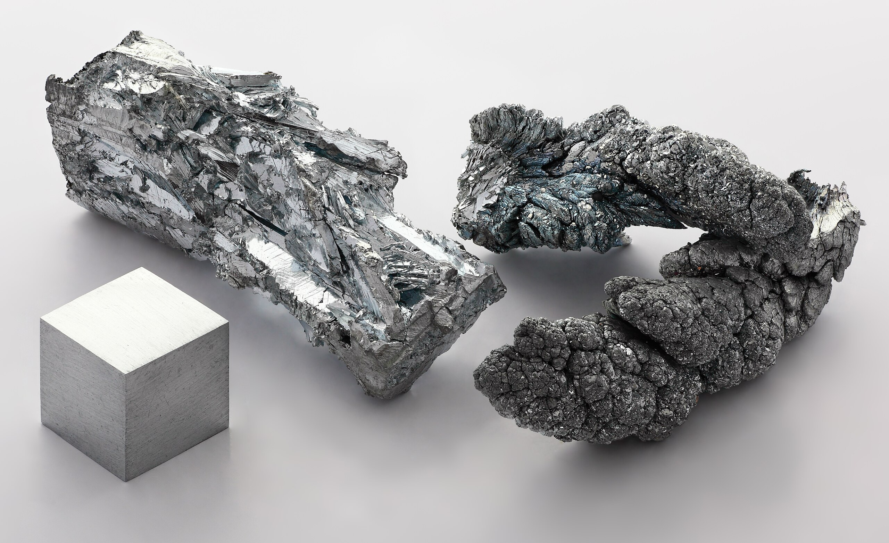





Zinc in everyday products
Zinc
Zn
Everyday products
Galvanised steel, construction materials
Projected Demand Increase by 2030
20 %
Found Primarily
China 2. Australia 3. Peru
Identified as a Clean Energy Metal?
Yes – Corrosion protection in renewable energies
Fun Fact
Zinc is essential for the human’s immune system and wound healing.
Return to overview
Notes:
https://resourcecapitalfunds.com/insights/mining-and-minerals-101/smartphone-metals-minerals/

Slide 17
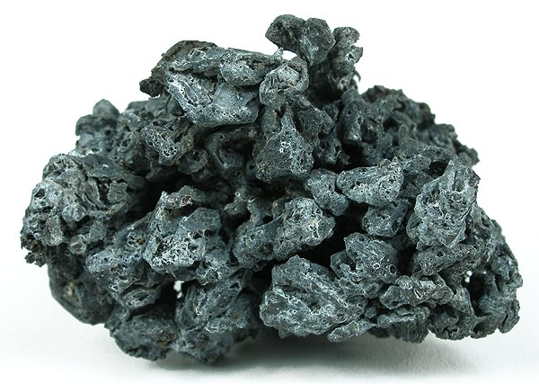
Lead in everyday products
Lead
Pb
Everyday products
Batteries, radiation shielding
Projected Demand Increase by 2030
15 %
Found Primarily
China 2. Australia 3. Peru
Identified as a Clean Energy Metal?
Yes – Backup energy systems
Fun Fact
Lead is used by humans for at least 7,000 years.
Return to overview
Notes:
https://resourcecapitalfunds.com/insights/mining-and-minerals-101/smartphone-metals-minerals/

Slide 18
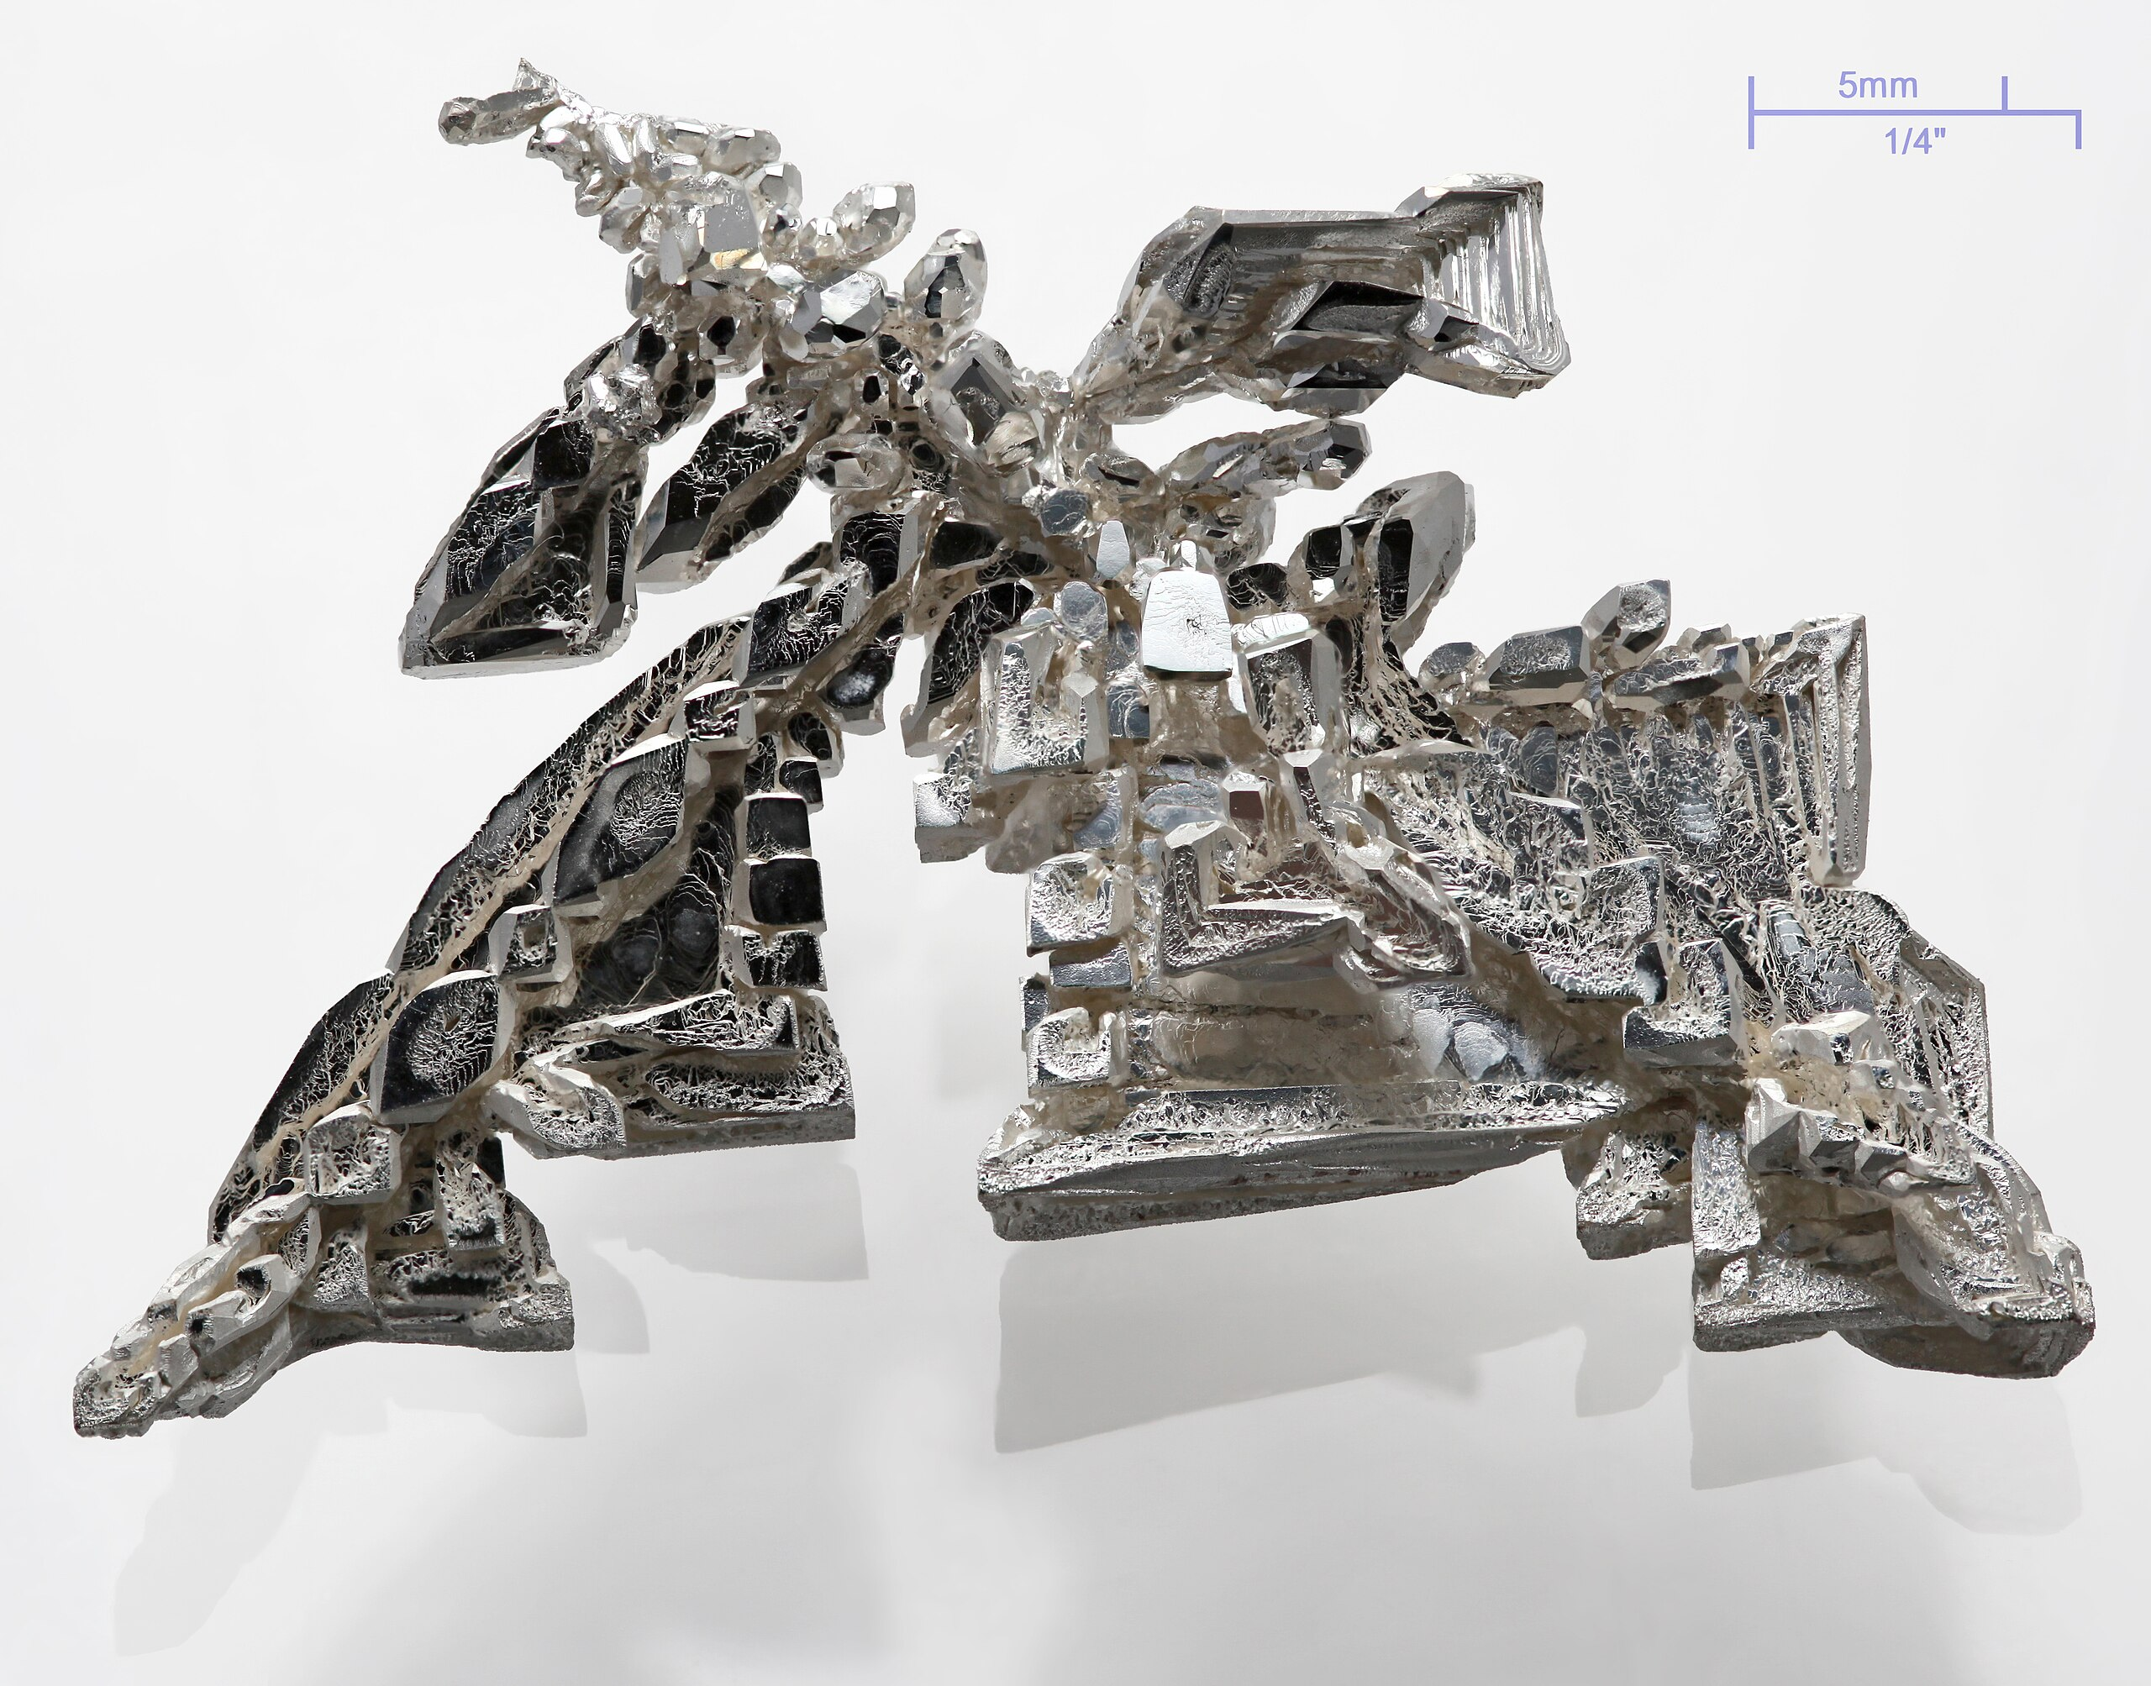
Silver in everyday products
Silver
Ag
Everyday products
Electronics, Solar panels
Projected Demand Increase by 2030
35 %
Found Primarily
Mexico 2. China 3. Peru
Identified as a Clean Energy Metal?
Yes
Fun Fact
Silver is the best natural conductor of electricity of all metals.
Return to overview
Notes:
https://resourcecapitalfunds.com/insights/mining-and-minerals-101/smartphone-metals-minerals/

Slide 19
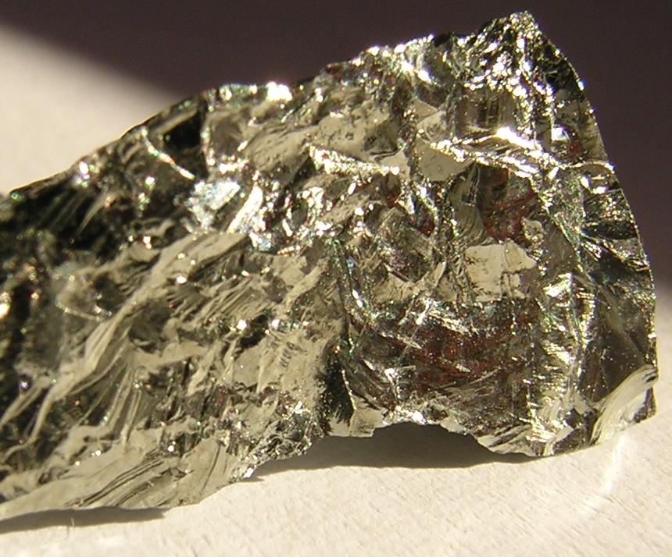
Germanium in everyday products
Silver
Ge
Everyday products
Fiber-optics, infrared, solar cells
Projected Demand Increase by 2030
40 %
Found Primarily
China 2. Canada 3. USA
Identified as a Clean Energy Metal?
Yes
Fun Fact
Mendeleev predicted Germanium at the exact right spot in the periodic system before its discovery.
Return to overview
Notes:
https://resourcecapitalfunds.com/insights/mining-and-minerals-101/smartphone-metals-minerals/

Slide 20
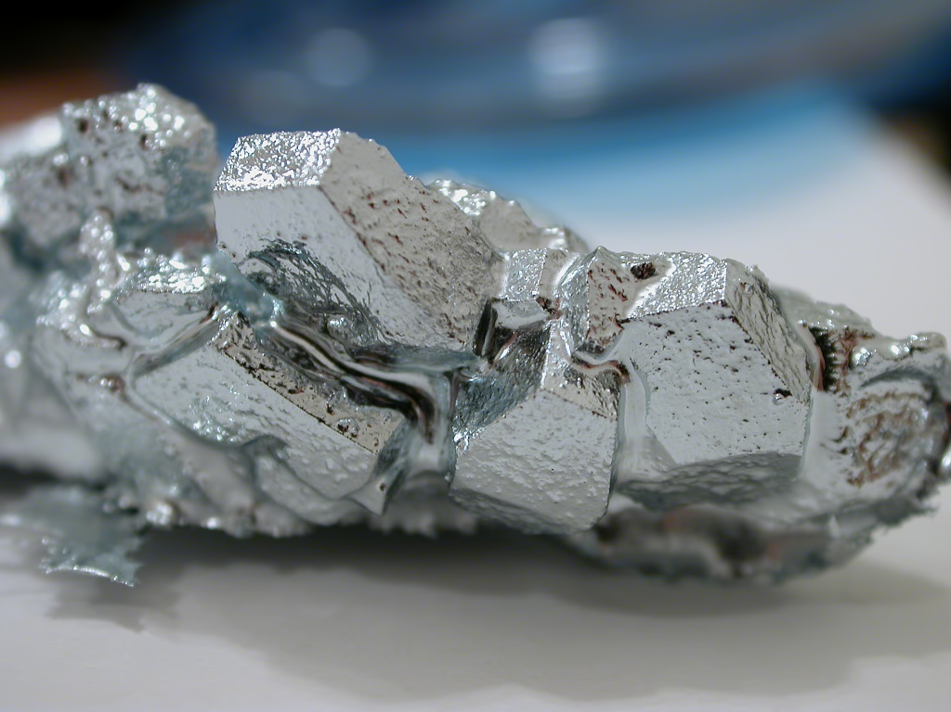
Gallium in everyday products
Silver
Ga
Everyday products
LEDs, smartphones, radar systems
Projected Demand Increase by 2030
85 %
Found Primarily
China 2. Kazakhstan 3. Germany
Identified as a Clean Energy Metal?
Yes
Fun Fact
Gallium has a very low melting point of 30°C, but an exceptionally high boiling point of 2,200°C.
Return to overview
Notes:
https://resourcecapitalfunds.com/insights/mining-and-minerals-101/smartphone-metals-minerals/

Slide 21
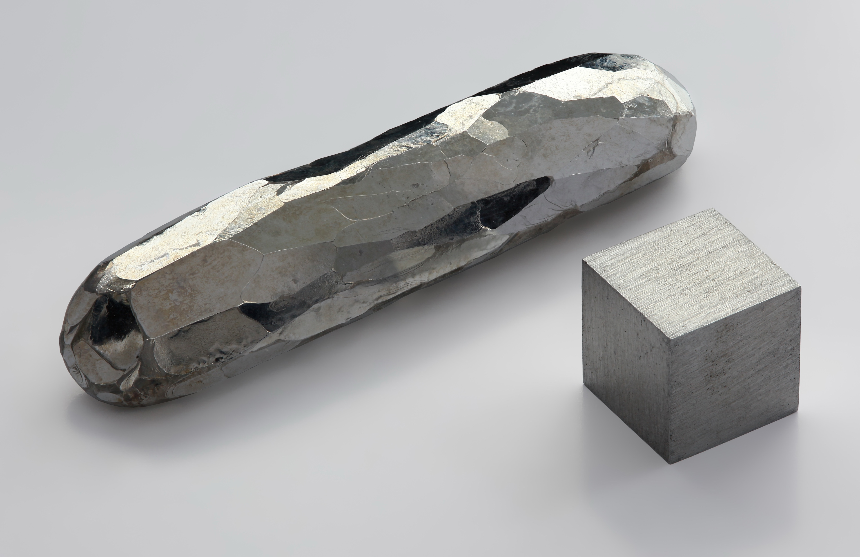
Cadmium in everyday products
Silver
Cd
Everyday products
Batteries, Solar panels
Projected Demand Increase by 2030
15 %
Found Primarily
China 2. Korea 3. Japan
Identified as a Clean Energy Metal?
Yes, but very regulated (toxic)
Fun Fact
Cadmium pigments (extremely bright reds & yellows) are historically used for paintings.
Return to overview
Notes:
https://resourcecapitalfunds.com/insights/mining-and-minerals-101/smartphone-metals-minerals/

Slide 22
References Maarmorilik
Internal slide?
https://eng.geus.dk/media/13331/go02_2ed.pdf
https://www.eolss.net/sample-chapters/c05/E6-37-06-02.pdf
https://data.geus.dk/geusmap/?mapname=greenland_portal
https://www.youtube.com/watch?v=L8kfj33a6ZE
https://www2.dmu.dk/Pub/FR807.pdf
https://ecos.au.dk/en/researchconsultancy/themes/mining-and-environment/lead-zinc-mine-in-maarmorilik
https://ejatlas.org/conflict/black-angel-mine-Greenland
https://www.boliden.com/4a4ed8/globalassets/about-boliden/bolidens-history/100-magazines/boliden-100-part-3-1979-2001.pdf
https://usaminingnews.com/articles/amaroq-confirms-high-grade-critical-minerals-at-black-angel-mine
https://de.wikipedia.org/wiki/Datei:Cadmium-crystal_bar.jpg
https://de.wikipedia.org/wiki/Datei:Germanium.jpg
https://de.wikipedia.org/wiki/Datei:Gallium_crystals.jpg

Slide 23
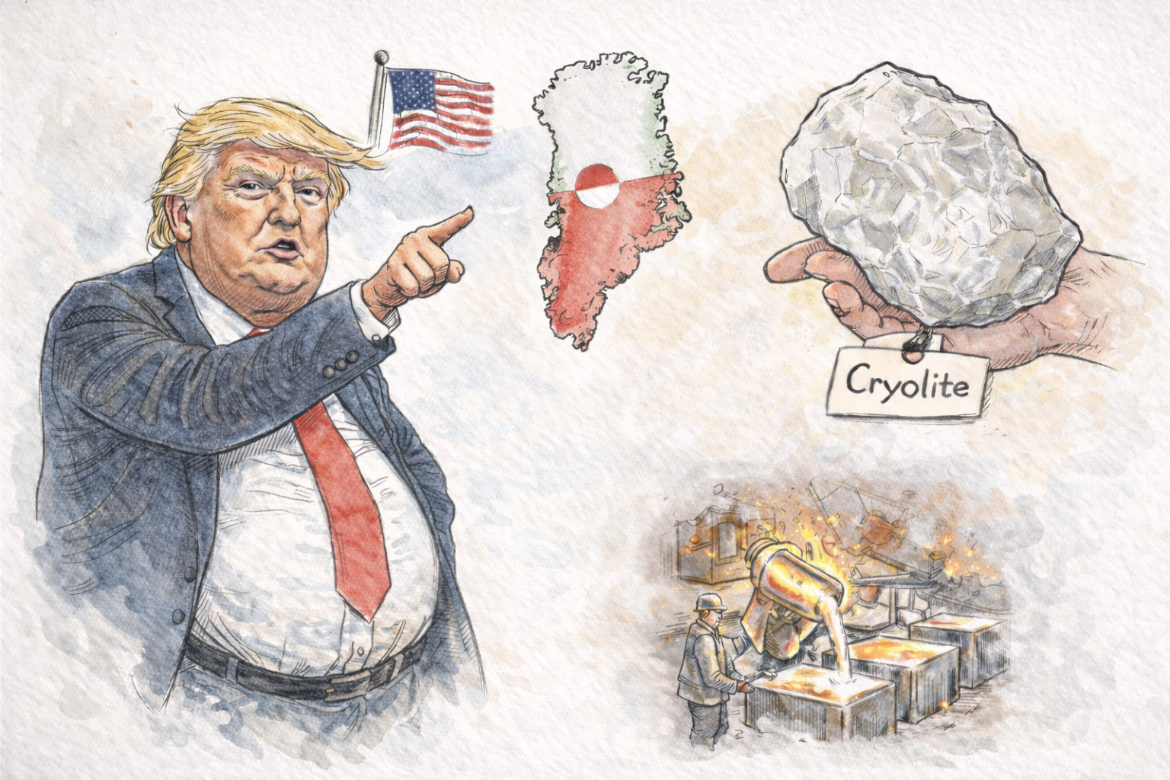
Ivittuut – national and global significance through mining
Geology and mine
and its purpose
Return to map
Past and current political importance
Notes:
Links ist eine form versteckt um den dicken anklicken zu können

Slide 24
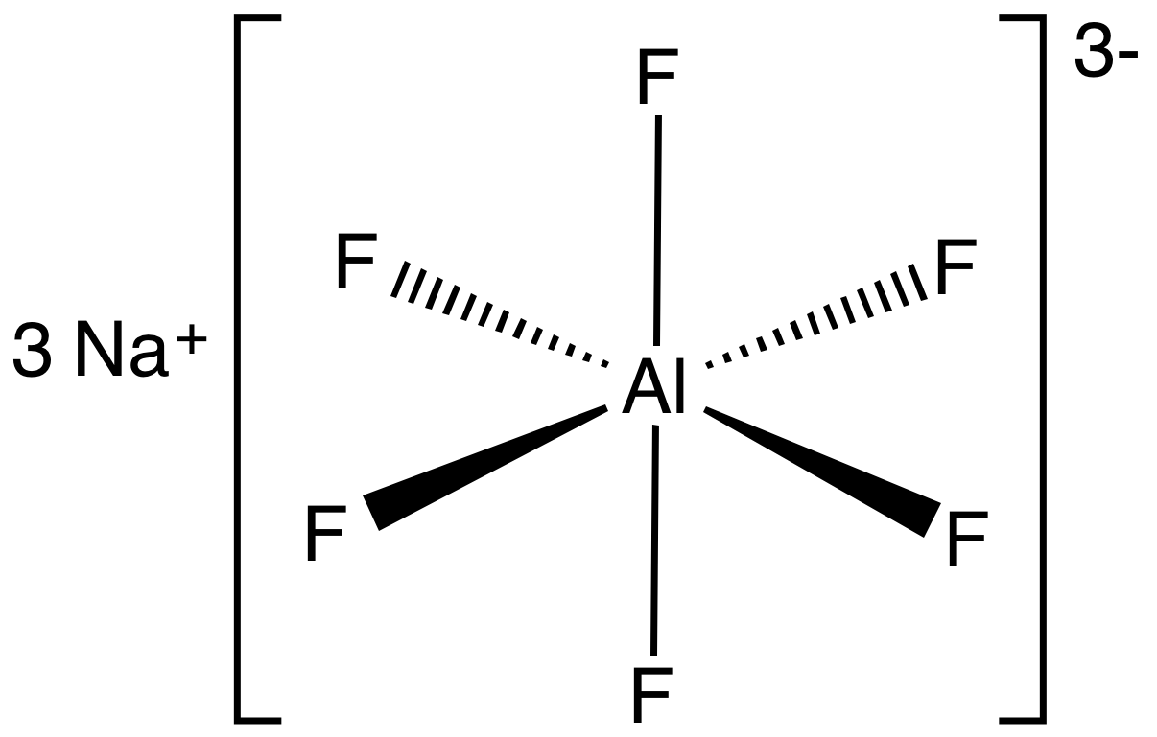

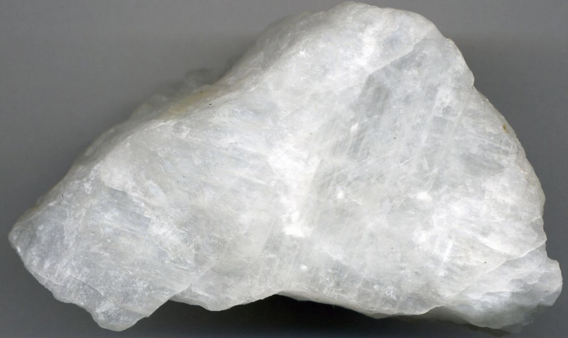
Cryolite
Sodium hexafluoroaluminate
Discovered in 1799
Naturally occurring as a mineral, but very rare
Used as flux in the Hall–Héroult process to produce Aluminum from oxides (mostly Bauxite)
Other uses: whitener for enamels, opacifier for glass
Nowadays synthetically produced
→ cheaper, independent of natural occurrence
Return to overview

Slide 25
Geopolitical significance of Ivittuut
Cryolite = “Critical Raw Material of the past”
But why is that arctic
hamlet still relevant?
Deposit found around the time of first Cryolite discovery
Cryolite mining in Ivittuut started in 1859 by Danish miners
Before synthesis was invented: Monopoly on Cryolite
Strategic importance for:
  Aluminum production
  Greenland’s economy benefited
  American occupation in WW II
  → US Navy even built the Bluie West Seven Base, sent coast guards & weapons to protect the quarry!

Slide 26
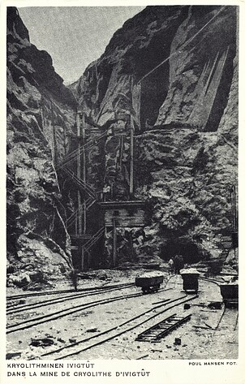
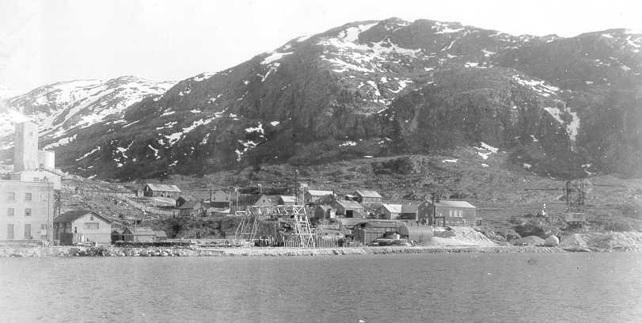
Why and how mine Cryolite in Ivittuut?
Governed by Geology
Deposit formed by fluor- and sodium-rich magmatic
intrusions into alkaline country rock (ca. 1.3 Ba ago)
Orebody is shallow, massive, pure, not finely disseminated
→ Open pit mining, little mineral processing economically feasible,
no selective methods needed
What happened to the mine?

Slide 27
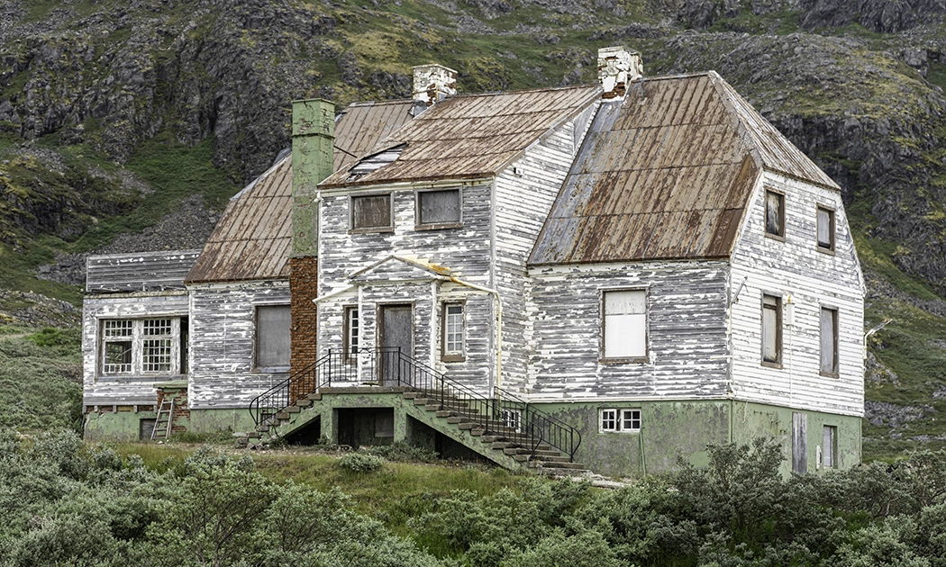
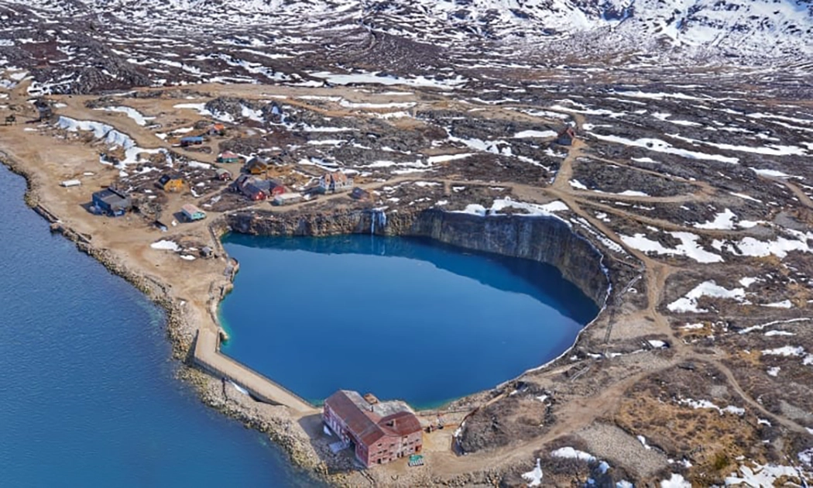
Ivittuut, 1960’s - now
Mine closure and the withdrawal of people
Synthetic Cryolite reduced the mine’s importance drastically
Mining became uneconomic,
sales from stockpiles continued
1987: final mine shutdown
Settlement was abandoned
soon after
What about the environment?

Slide 28
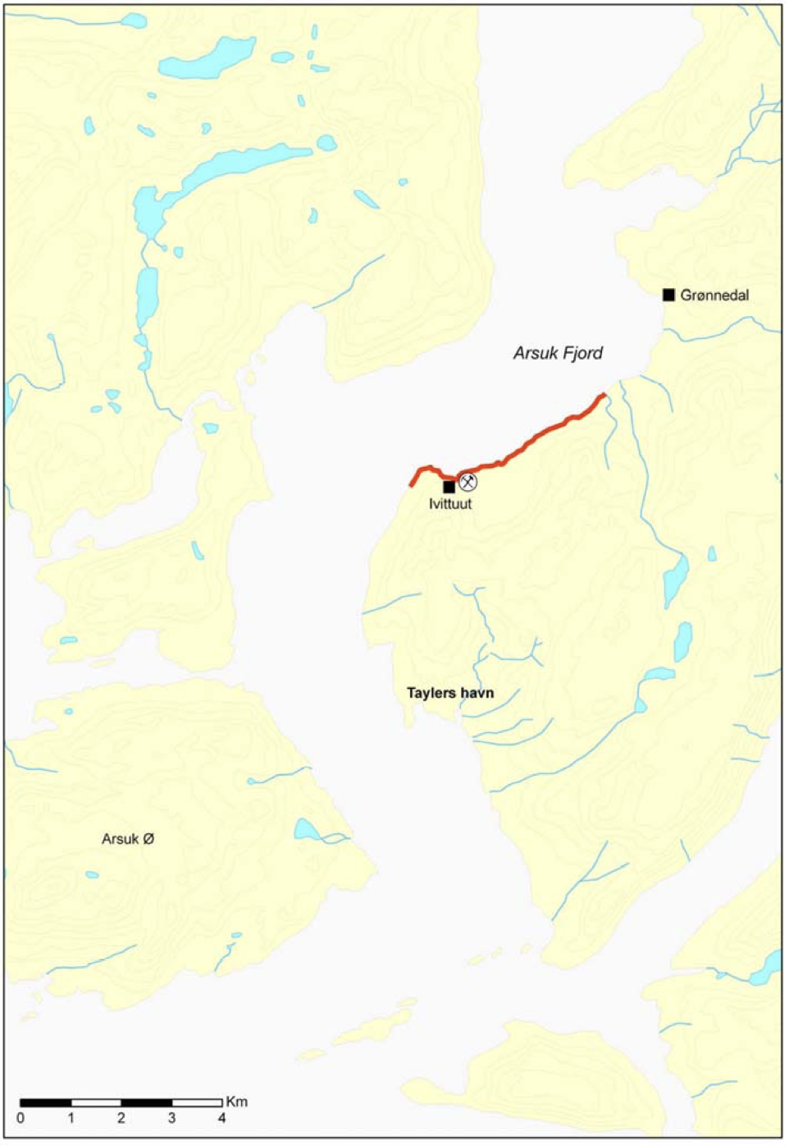
What went wrong?
Environmental pollution from Ivittuut Mine
Arsuk Fjord was polluted with Zinc and Lead
Main pollution source: mineralized waste rock from Ivittuut
(similar to pollution in Maarmorilik)
Much higher metal contaminant concentrations observed
Affected coastline 32 kilometers long
Mussels in red area (figure on the left) may not be consumed
As of 2014, these pollution-causing rocks
still released Lead and Zinc into the fjord
Return to overview

Slide 29

Why does Ivittuut still matter today?
Although abandoned, it remains a symbol:
Greenland’s mineral wealth in-
fluences the interest in the island
Historical military alliances could crack
Contemporary debates about
  Resource governance
  Autonomy
  Economic partnerships
  concern Greenland more than ever
→ Natural resources can shape global power dynamics!
Return to overview

Slide 30
References Ivittuut
Internal slide?
https://www.abc.net.au/news/2026-01-23/donald-trump-greenland-maps-explain-battle-for-arctic/106248192
https://dce2.au.dk/pub/SR105.pdf
https://dce.au.dk/udgivelser/vr/nr-101-150/abstracts/no-105-environmental-monitoring-in-2013-at-the-cryolite-mine-in-ivittuut-south-greenland/
https://www.mindat.org/loc-1958.html
https://polarjournal.net/ivittuut-greenlands-forgotten-cryolite-capital/
https://en.wikipedia.org/wiki/Sodium_hexafluoroaluminate
https://en.wikipedia.org/wiki/Greenland_in_World_War_II
https://en.wikipedia.org/wiki/Ivittuut

Slide 31





Key takeaways
Greenland has already shaped global power in the past.
Critical Raw Materials (CRMs) are a present, not a future issue. The EU depends on imports for over 90% of CRMs.
High-grade deposits matter dispropotionately. Greenland is expected to have many of such.
Everyday choices influence global resource pressure. Extend item lifetimes!
Ivittuut and Black Angel ask a question that remains unanswered: Who decides about resources and who benefits when demand-, security- and community-interests intersect?

